Slide 1
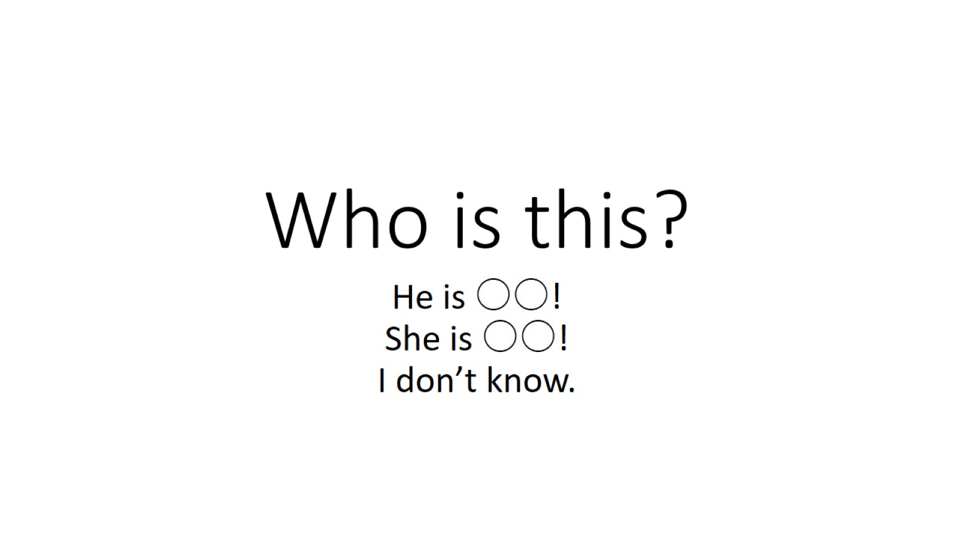
Who is this?

Slide 2

1

Slide 3
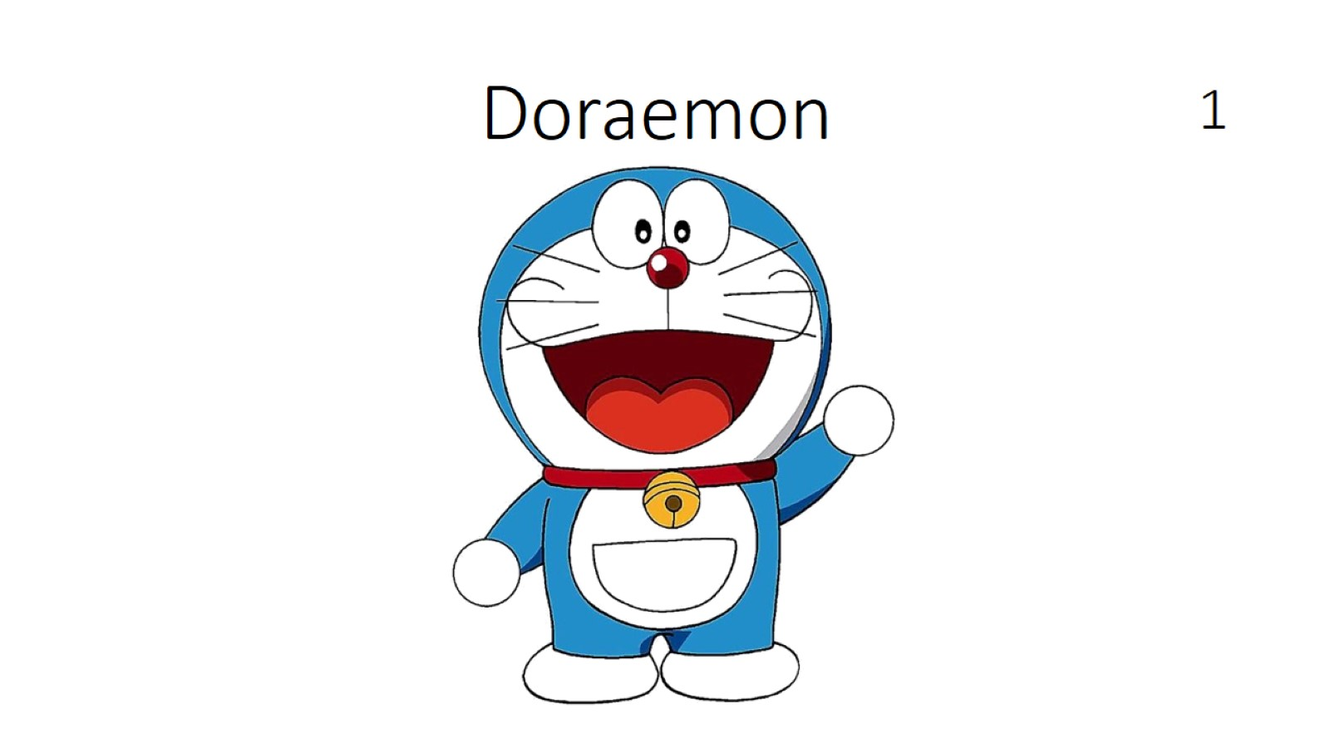
1

Slide 4

2

Slide 5
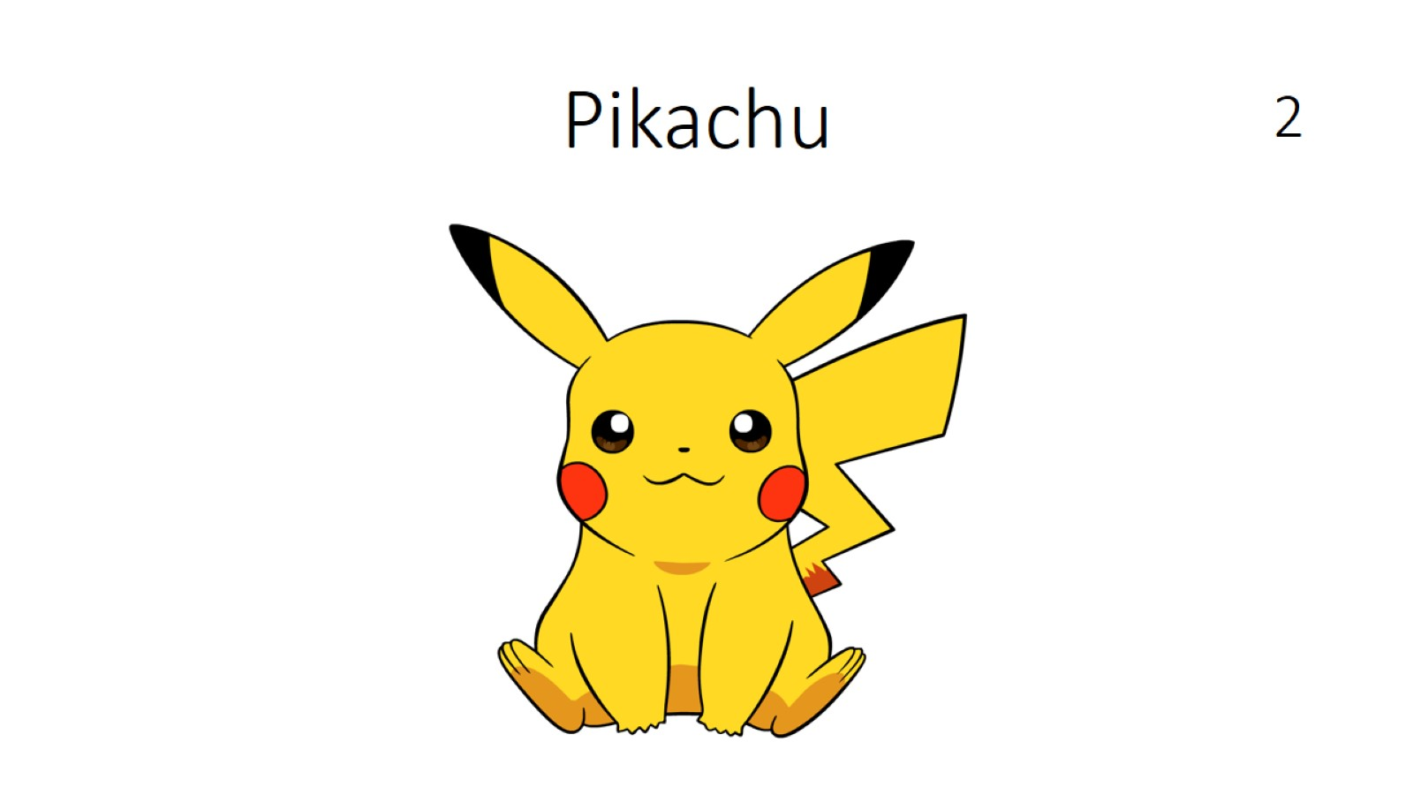
2

Slide 6

3

Slide 7
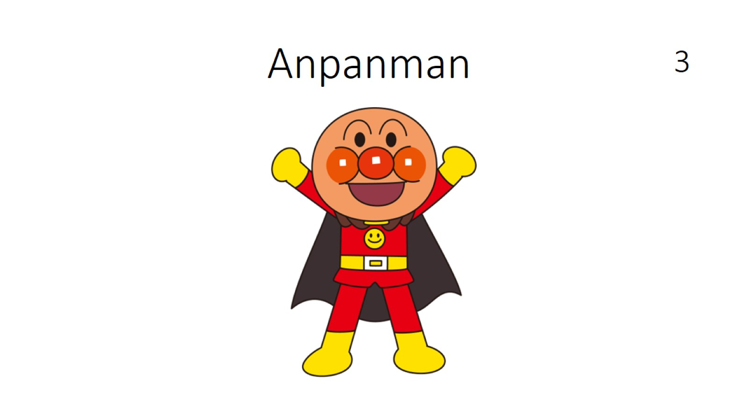
3

Slide 8

4

Slide 9
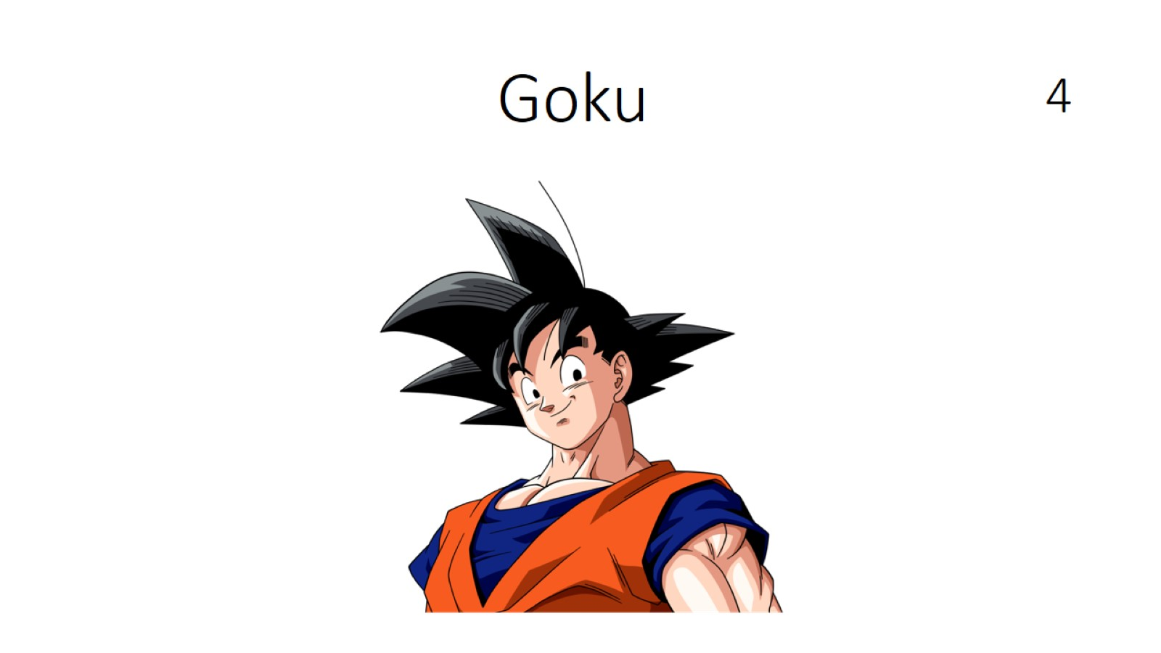
4

Slide 10

5

Slide 11
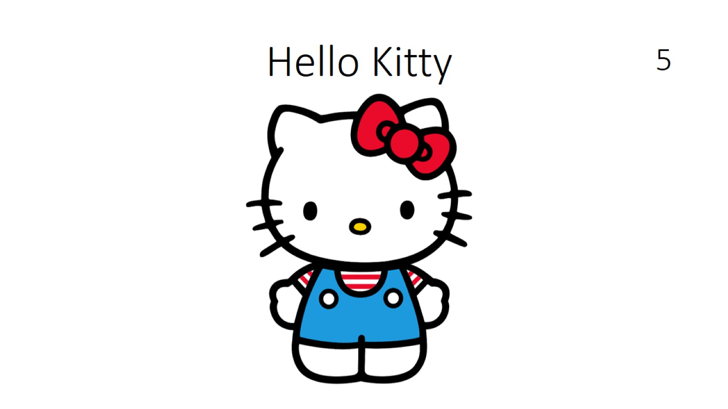
5

Slide 12

6

Slide 13
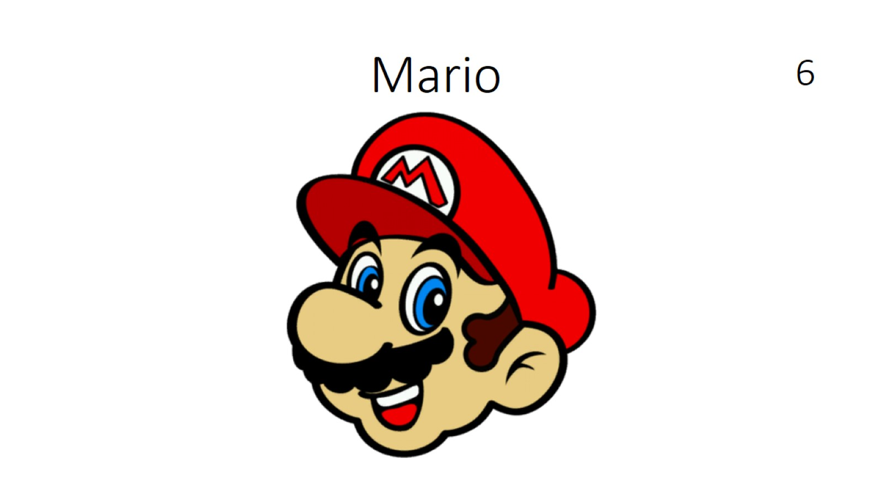
6

Slide 14
